Slide 1
Getting Started Checklist
Phase 1: Foundation
☐ Create core instruction files for your tech stack
☐ Establish coding standards and quality gates
☐ Define security and compliance requirements
☐ Test instruction file effectiveness
Phase 2: Automation
☐ Identify repeatable development tasks
☐ Create prompt files for common workflows
☐ Build task-specific execution templates
☐ Validate prompt file outputs

Slide 2
Getting Started Checklist (Continued)
Phase 3: Specialization
☐ Identify domain expertise needs
☐ Create custom chat modes for key roles
☐ Test conversational effectiveness
☐ Document mode usage guidelines
Phase 4: Integration
☐ Combine approaches for complex workflows
☐ Establish team usage standards
☐ Create training materials
☐ Monitor and iterate on effectiveness

Slide 3
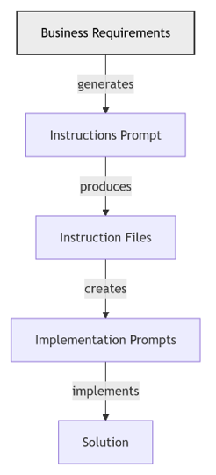
High Level AI Assisted Workflow
From Requirements to a Solution
Stakeholders (SMEs, Architects, SREs, DBAs, etc.) define the requirements with AI assistance
AI transforms the requirements into implementation instructions files that guide the implementation
Stakeholders review, improve, and approve the instruction files
AI uses instruction files to create prompts to implement the business requirements
Implementation prompts tell AI how to implement a feature and how to verify that the feature meets the acceptance criteria
Stakeholders review, improve, and approve the implementation prompts
Submitting the implementation prompts
Generates an implementation that conforms to the implementation instructions and meets the acceptance criteria
Stakeholders review and approve implementation

